Slide 1
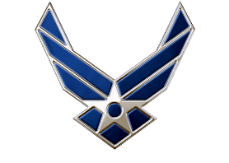

Pass In Review
Air Force ROTC Detachment 842
The University of Texas at San Antonio
C/Vallor and C/Al Luhaibat
04 Dec. 2024

Slide 2


Overview
Placemat
POC Roles
POC Timeline
Supplementary Info
Diagram
Questions
Air Force ROTC Detachment 842 • We Build Exceptional Officers • The University of Texas at San Antonio

Slide 3

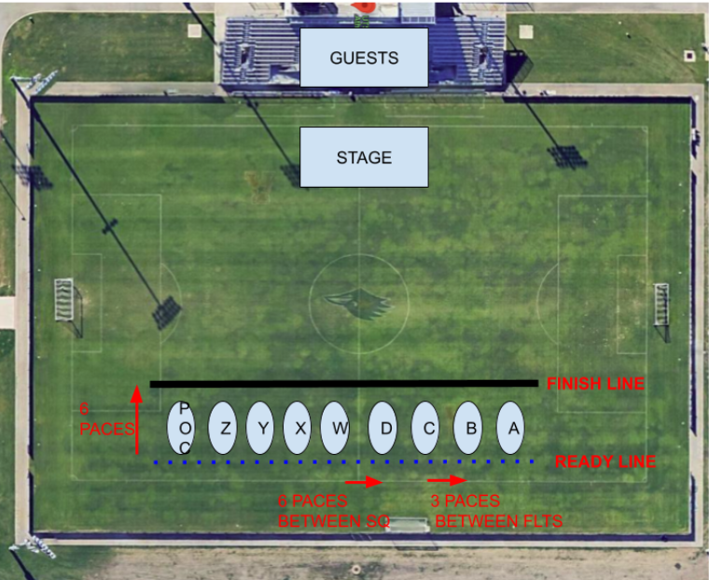
Mission:
UTSA Det 842 will be conducting our inaugural Pass and Review. This event is the culmination of the semester, and will include the changing of command and the review of the Wing by the Commander.
CONOPS:
Pass In Review
Units Tasked:
INTERNAL:
GMC: All Flights
POC: All Flights
EXTERNAL:
UTSA Staff
Concept of the Operation:
Flights will form up at the Park West field by 1645 on 05 December 2024. Accountability will be taken. We will then conduct the changing of command, showcase warrior and honor flight and finally conduct pass and review.
Tasks to Staff:
Force Protection: Safety
Logistics - Transportation, uniforms
Operations - Review and Conduct D&C
Public Affairs - Provide media coverage (photos/videos), update social media sites
Timeline:
13Oct 2024
Disseminate Information with A3
05Nov2024
Initial practice with Command Staff
12/14thNov2024
Initial practice with ALL POC
19, 21Nov2024 and 3Dec2024
PT Practices
21NOV2024
1700: Official Wing Practice
05DEC2024
1600: LLAB team + Add ComSup personnel arrive
1615: Gates Open
1645: Pass In Review Begins
1735: Pass In Review Concludes
Coordinating Instructions
UNIFORM: Blues/Alternates
VEHICLES:GOV to transfer equipment/Personal Vehicles
EQUIPMENT: Speakers, microphones, cones
COMMUNICATION: Slack
FUNDING: Detachment
DATE/TIME IDENTIFIED | VENUE CONFIRMED | TRANSPORTATION CONFIRMED | GUESTS CONFIRMED
RECON CONDUCTED | INFORMATION SENT | REHEARSAL CONDUCTED | AAR CONDUCTED
Risk Assessment
Hazard | Initial Risk Level | Mitigated Risk Level
Tripping | Med | Low
Cars/Traffic | Low | Low
Heat Stress | Med | Low

Slide 4
POC Roles
A5:
Assist in setting up seats on the field for cadre and distinguished visitors
Control guest traffic -> direct to bleachers
get aid from Addition ComSup Personnel if needed
assist those with special accommodations (wheelchair/walker)
Once the event has started: Maintain Perimeter Security under Force Protection
Force Protection:
Lead and Maintain Perimeter Security during the event
Air Force ROTC Detachment 842 • We Build Exceptional Officers • The University of Texas at San Antonio

Slide 5
Timeline
1500-1600: Arrive and Set Up at Parkwest
1615: Cadets Arrive
A3 Accountability Completed by: 1630
1630: Gates Open to Guests
1640: Flights Should be in Position on Field
1645: Start of PIR
1735: Conclusion of PIR
1745-1800: Take down/Potluck
Air Force ROTC Detachment 842 • We Build Exceptional Officers • The University of Texas at San Antonio

Slide 6
Supp. Info
UOD: Blues/Service Dress
Field Seats:
3 from UTSA
1 from Region
10 Cadre
5 Command Staff
Those not in A3/A5/Force Protection should report to POC flight for the event
Air Force ROTC Detachment 842 • We Build Exceptional Officers • The University of Texas at San Antonio

Slide 7
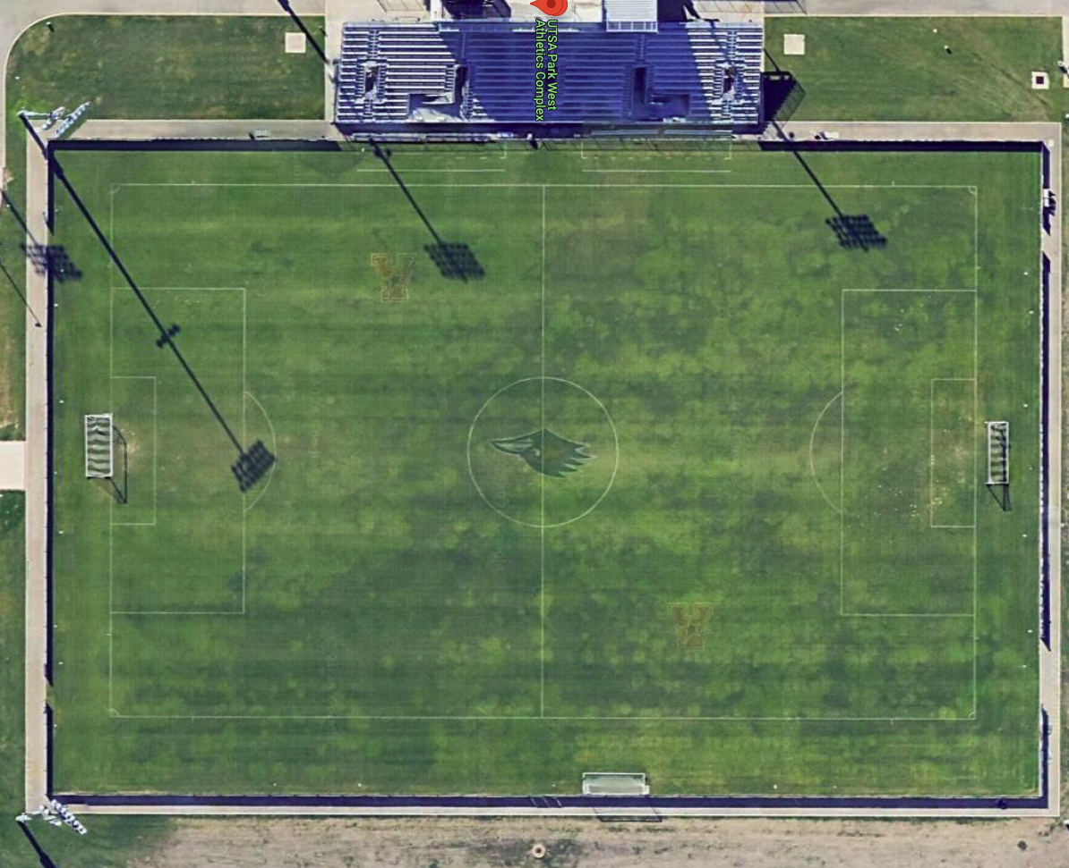
Soccer Field Diagram
= Force Protection Posts
Audience
Field Seats
Field Seats
Sqd 2
Sqd 1
Air Force ROTC Detachment 842 • We Build Exceptional Officers • The University of Texas at San Antonio

Slide 8
Questions?

